Slide 1
DEPLOYMENT AND MAINTENACE
CT026-3-1-Systems Analysis and Design

Slide 2
Topic Learning Outcomes
At the end of this topic, you should be able to:
1. Explain changeover strategies
2. Discuss the maintenance tasks
3. Discuss the maintenance management

Slide 3
Contents & Structure
Deployment
System Changeover Strategies
Maintenance
Maintenance tasks
Maintenance Management

Slide 4
Key terms you must be able to use
If you have mastered this topic, you should be able to use the following terms correctly in your assignments and exams:
Corrective Maintenance
Adaptive Maintenance
Perfective Maintenance
Preventive Maintenance

Slide 5
Recap From Last Lesson
Identify three (3) types of testing?

Slide 6
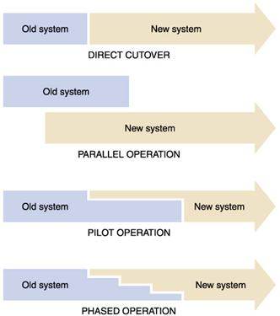
System Change-over Strategies (How the old system will be replaced with new?)

Slide 7
System Change-over Strategies (How the old system will be replaced with new?)
Direct cutover: New system replaces old system immediately
Parallel operation (or parallel running): Both old and new system are run simultaneously for a period
Pilot operation: New system, is introduced in just one branch of a organisation.
Phased operation: New system is added a bit at a time

Slide 8
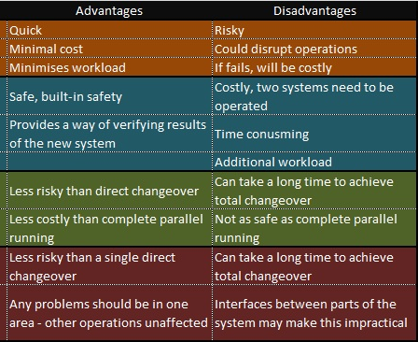
System Change-over Strategies (How the old system will be replaced with new?)
Direct Cutover
Parallel Operation
Pilot
Operation
Phased Operation

Slide 9
Software Maintenance
The process of modifying a software system or component after delivery to correct faults, improve performance or other attributes, or adapt to a changed environment

Slide 10
Maintenance Tasks
Maintenance expenses
Vary significantly during the system’s operational life and include spending to support maintenance activities
Maintenance activities
Programs, procedures or documentation to ensure correct system performance
Adapt the system to changing requirements
Make the system operate more efficiently

Slide 11
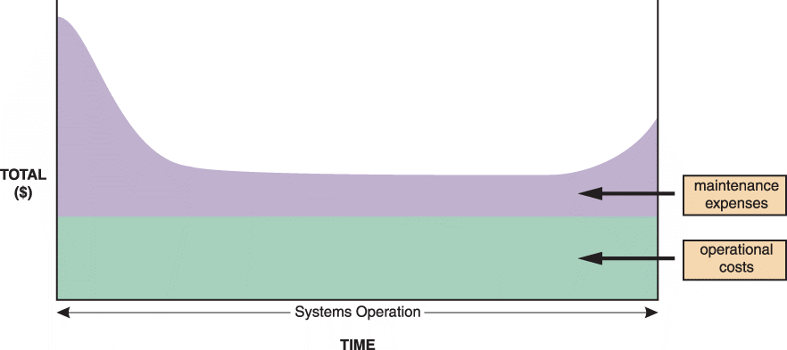
Maintenance Tasks
FIGURE 12-4 The total cost of operating an information system includes operational and maintenance costs. Operational costs (green) are relatively constant, while maintenance costs (purple) vary over time

Slide 12
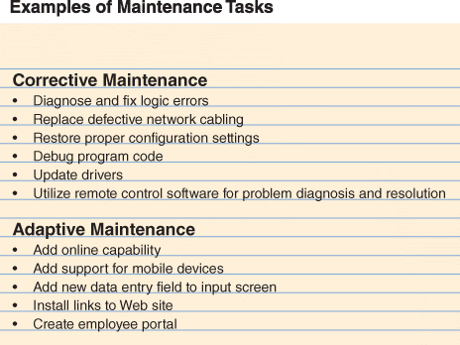

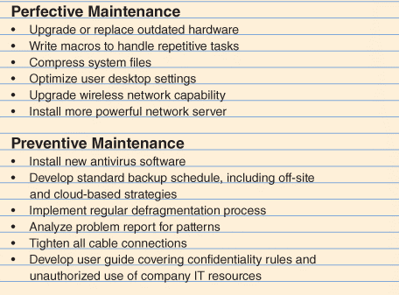
Maintenance Tasks
FIGURE 12-5 Corrective maintenance fixes errors and problems. Adaptive maintenance provides enhancements to a system. Perfective maintenance improves a system’s efficiency, reliability, or maintainability. Preventive maintenance avoids future problems

Slide 13
Maintenance Tasks
Corrective Maintenance
Diagnoses and corrects errors in an operational system
Respond to errors in various ways, depending on nature
Worst-case situation is a system failure
When the system is operational again, the maintenance team determines the cause, analyzes the problem, and designs a permanent solution

Slide 14
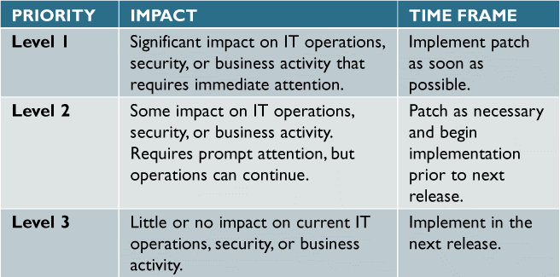
Maintenance Tasks
Adaptive Maintenance
Adds enhancements to an operational system and makes the system easier to use
The procedure for minor adaptive maintenance is similar to routine corrective maintenance
Can be more difficult than new systems development because the enhancements must work within the constraints of an existing
system
FIGURE 12-7 This three-level ranking framework for IT support considers potential impact and response urgency

Slide 15
Maintenance Tasks
Perfective Maintenance
Involves changing an operational system to make it more efficient, reliable and maintainable
Cost-effective during the middle of the system’s operational life
Programs that need a large number of maintenance changes usually are good candidates for reengineering
The more a program changes, the more likely it is to become inefficient and difficult to maintain

Slide 16
Maintenance Tasks
Preventive Maintenance
Requires analysis of areas where trouble is likely to occur
IT department normally initiates preventive maintenance
Often results in increased user satisfaction, decreased downtime
Sometimes does not receive the high priority that it deserves

Slide 17
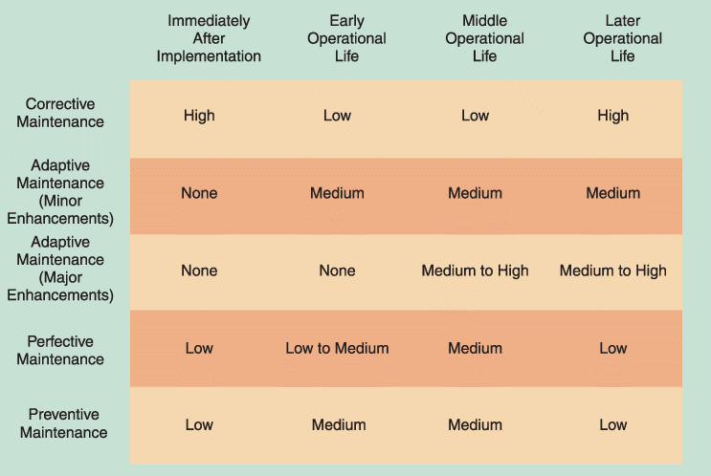
Maintenance Tasks
FIGURE 12-6 Information systems maintenance depends on the type of maintenance and the age of the system

Slide 18
Maintenance Management
The Maintenance Team
System administrator
- Manages computer and network systems
Systems analysts
- Investigate and rapidly locate the source of a problem by using analysis and synthesis skills
Programmers
- Applications programmers work on new systems development and maintenance
- Systems programmers concentrate on operating system software and utilities
- Database programmers focus on creating and supporting large-scale database systems
Organisational issues
- Maintenance team vs. new systems development team

Slide 19
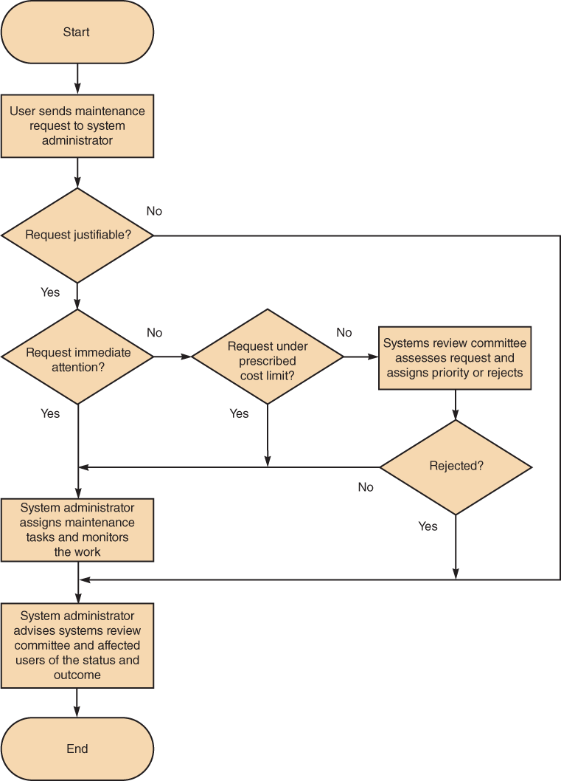
Maintenance Management
Maintenance Requests
Involve a series of steps
All work must be covered by a specific request
Initial determination
The systems review committee
Task completion
User notification
FIGURE 12-10 Although the procedure varies from company to company,
the chart shows a typical process for handling maintenance requests

Slide 20
Maintenance Management
Initial Determination
System administrator makes the initial determination if are justifiable
The System Review Committee
Either approves the request and assigns a priority to it, or rejects it
Task Completion
System administrator usually assigns tasks to individuals or to a maintenance team
User Notification
Users who initiate maintenance requests expect a prompt response, especially if the situation directly affects their work

Slide 21
Maintenance Management
Establishing Priorities
In many companies, systems review committee separates maintenance requests from new systems development requests
Some IT managers believe that evaluating all projects together leads to the best possible decisions
Object is to have a procedure that balances new development and necessary maintenance work

Slide 22
Summary
Maintenance
Maintenance tasks
Maintenance Management

Slide 23
Question and Answer Session
Q & A

Slide 24
What To Expect Next Week
In Class
Preparation for Class
Mock test
Download the slide and study for the all chapters.

